Slide 1

Final Year Project Presentation
On
HOMEIN : A Real Estate Website
Submitted by :
Ashwani Tandon(151465)

Slide 2
Contents
Introduction
Objective
Agile Methodology
Burn down Chart
MVC Framework
System Requirements
Implementation
Results
Conclusion

Slide 3
Introduction
In an era of web apps and connectivity, web users are becoming increasingly enthusiastic about working together through online.
With a growing impact on everyday life, such as in education, health, commerce and tourism, leading to an exponential growth in the size of the web.
However, we think about the real estate management portal to make users on single platform to work together and make life easy and fast.

Slide 4
Objective
Designing, developing, managing and leasing real estate properties..
Ownership, management and leasing of commercial properties, office space properties, mixed-use properties and residential properties.

Slide 5
Agile Methodology
Agile software development is a conceptual framework for software engineering that promotes development iterations throughout the life-cycle of the project.
Software developed during one unit of time is referred to as an iteration, which may last from one to four weeks.
Agile methods also emphasize working software as the primary measure of progress.

Slide 6
Contd...
Characteristics of Agile Software Development
-- Light Weighted methodology
-- Small to medium sized teams
-- vague and/or changing requirements
-- vague and/or changing techniques
-- Simple design
-- Minimal system into production

Slide 7
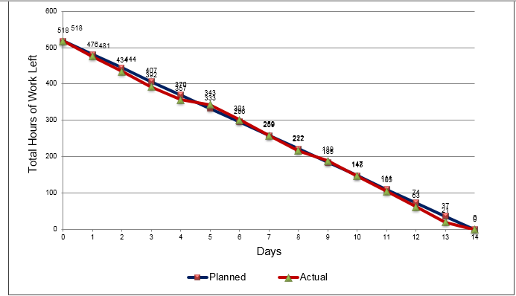
Burndown Chart

Slide 8
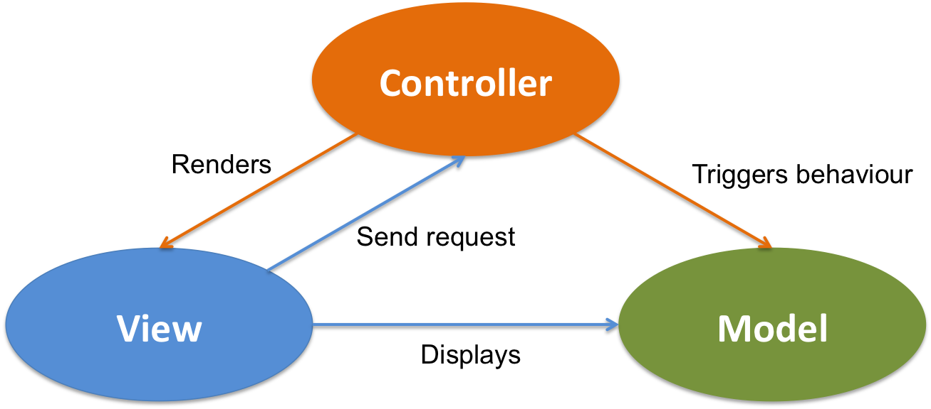
MVC Framework

Slide 9
Contd..
Model : Model represents an object. It can also have logic to update controller if its data changes.
View : View represents the visualization of the data that model contains.
Controller : Controller acts on both model and view. It controls the data flow into model object and updates the view whenever data changes. It keeps view and model separate.

Slide 10
System Requirements
Software used: Visual Studio
Why Visual Studio?
Visual Studio code editor supports IntelliSense (the code completion component) as well as code refactoring.
Some other alternatives: Eclipse, IntelliJ Idea
Minimum Hardware Requirements:
Pentium processor ---1 GHz or above
RAM Capacity ---1GB
Hard Disk ---- 80GB

Slide 11
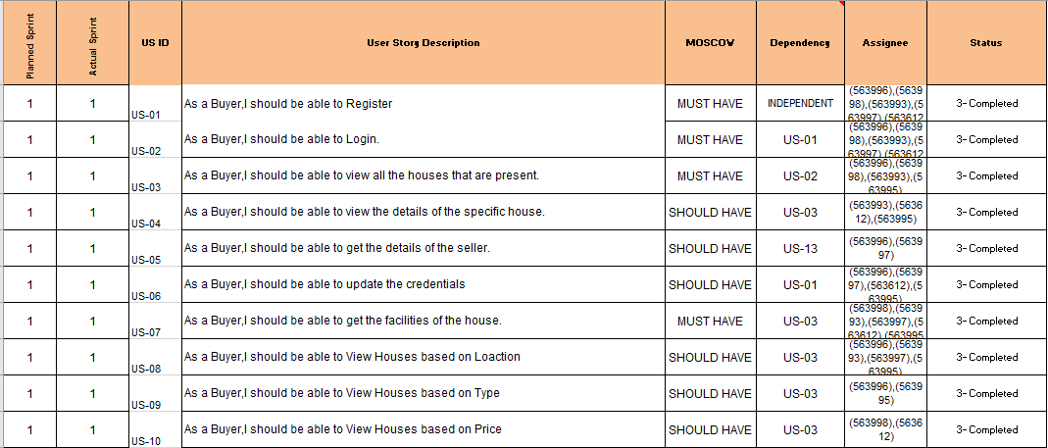
Work

Slide 12
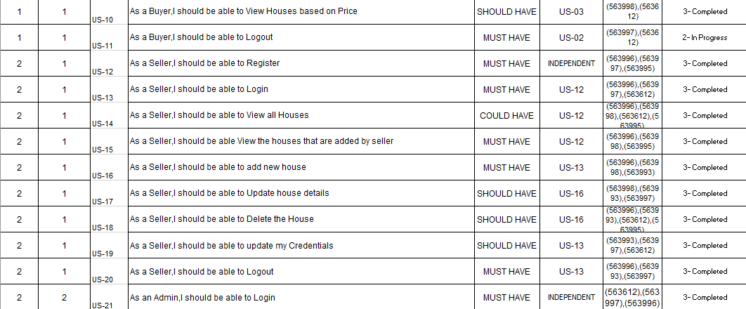
Contd..

Slide 13
Implementation
Technology Used:
C# (Data Access Layer)
Angular 6 (Front End)
Application Programming Interface (API)
SQL (Database)

Slide 14
Implementation
Database: We have used three tables for implementation.
Users : It will store all the buyers, sellers, admin details.
Home Details : It will store all the details of the houses.
Facilities : It will store all the facilities of the particular houses.

Slide 15
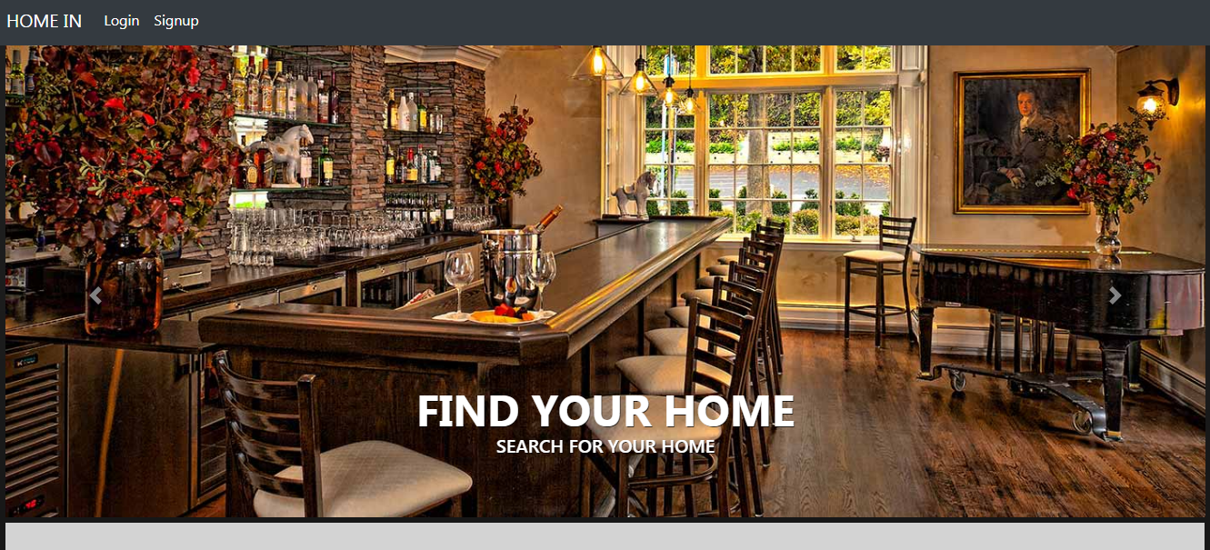
Results

Slide 16
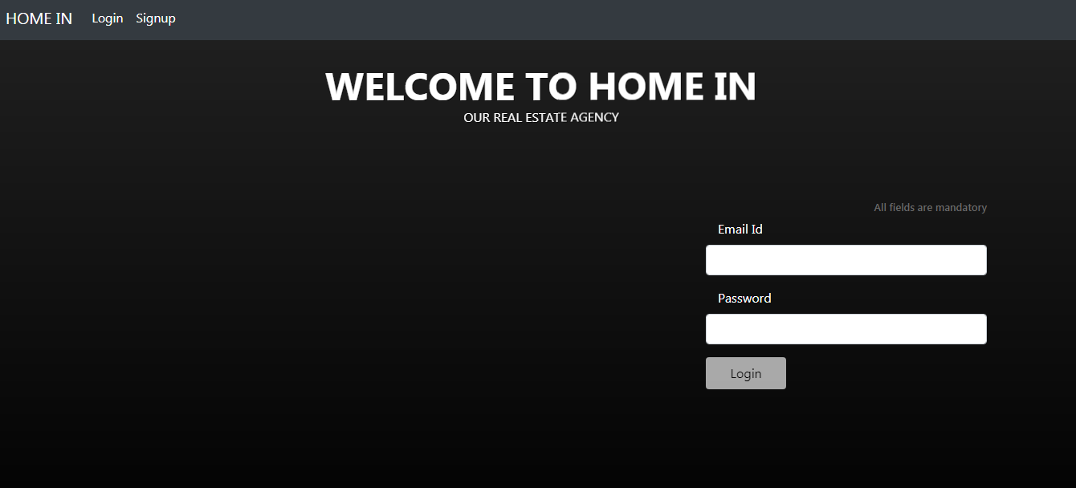
Results

Slide 17
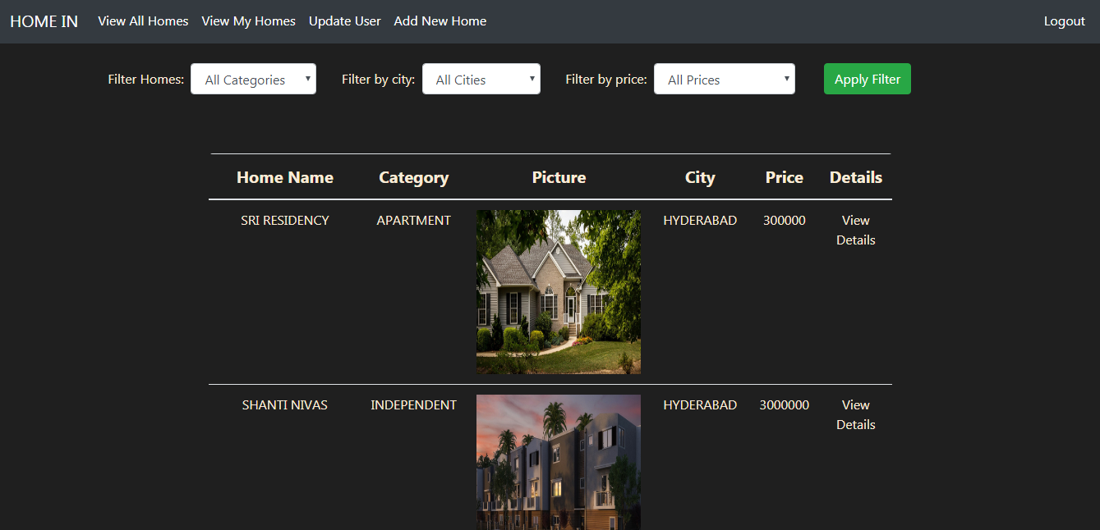
Results

Slide 18
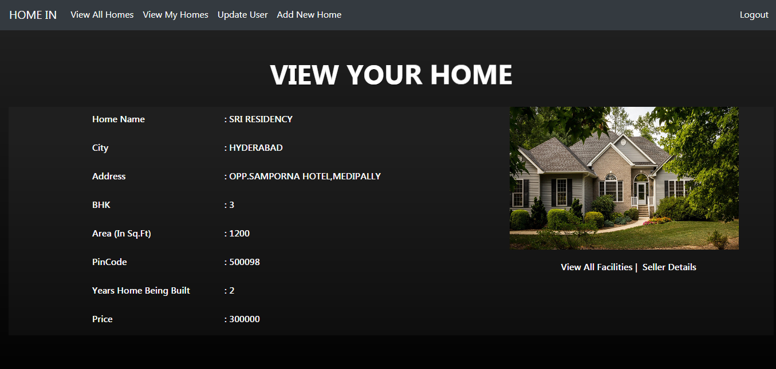
Results

Slide 19
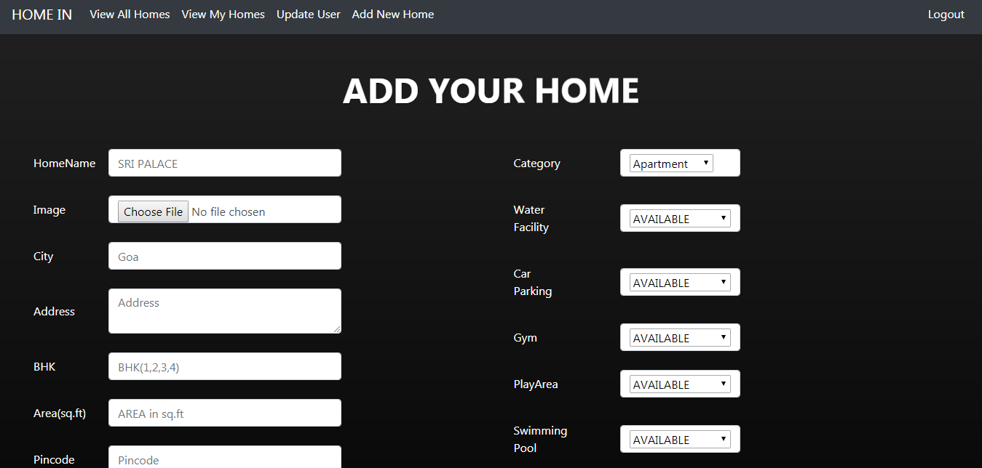
Results

Slide 20
Conclusion
I have learnt the flow of angular and integrated it with C# for the better security purposes.
As my project is able to resolve the issues like frauds and persons that will take money in order to provide houses, that can happen offline. But with the help of this project we are able to solve this problem.

Slide 21

References
Huang, Po-Sen; He, Xiaodong; Gao, Jianfeng; Deng, Li; Acero, Alex; Heck, Larry (2013-10-01). "Learning Deep Structured Semantic Models for Web Search using Social Data". Microsoft Research.
Ribeiro, Filipe Nunes; Araujo, Matheus (2010). "A Benchmark Comparison of State-of-the-Practice Sentiment Analysis Methods". Transactions on Embedded Computing Systems.

